Slide 1
Bluebonnet Learning Secondary Math:
Coach Assessments in HQIM
Point Isabel ISD
Workshop #374182
Remote Check In: Math
Notes:
:01
Say: Welcome to today’s session for coaches supporting Bluebonnet Learning Secondary Math: Assessments in HQIM.

Slide 2


Opening
Pg # 1
We’re glad you’re here!
Please Access your copies of the:
Assessments in HQIM Guided Notes
Combined Assessment Examples
Consider the following question and be ready to share:
What has been the benefit of reviewing assessments during Module/Topic Internalization?
What has been the challenge?
Notes:
:01-:03
Say: We’re so glad you’re here. As we’re getting settled, please pull up your guided notes and the Combined Assessment Document. Then, consider and be ready to share: What has been the benefit of reviewing assessments during the Module/Topic Internalization process? What has been the challenge? After participants get settled have them share the answer to the question on the slide with a partner, small group or whole group.
Notes and Session Resources:
Participants may pull these resources up electronically or you could print them off for table groups depending on your delivery context.
The Combined Assessment document begins with the assessments participants will be Deep Diving into for the “Connecting Summative and Formative” Section. After those 3 assessments are examples of the assessment types from the “Types of Assessments” Section.
Session Guided Notes Link: https://docs.google.com/document/d/1nfjmho7Hnw_fvYYaQH5PbUOFYAqH24rk/edit
Combined Assessments Link: https://drive.google.com/file/d/13OKMTGGkwFdwrH7mRMloU1S_b45znmPJ/view?usp=sharing

Slide 3




Norms for our Session
Engagement
Partnership
Curiosity
Grace
This work will support your students. Be an active participant in all learning experiences by sharing your thoughts and asking questions.
We are partners and our time is valuable. Please raise your hand and wait until others have finished their thoughts before you begin speaking.
We value your questions and will pause throughout our time together to answer questions.
Learning a new product for your subject can be challenging. You won't walk away today or even this year as experts. It's okay to walk away without a feeling of closure.
Notes:
:03
Say: Here are the norms I invite us to follow for each live session. We hope for these sessions to be filled with engagement, partnership, curiosity, and most importantly community. To ensure that we have sessions filled with these ideas, we’ve established these norms. First, please stay engaged and participate in all learning experiences. We also ask that you raise your hand to answer questions from the facilitator through the session.
Second, we want you all to feel as though you are partners in this work so if you have a question, please feel free to raise your hand. We want everyone to feel that what they think has value, so we ask that you wait for a person to finish their thoughts before speaking.
Third, please feel free to ask questions throughout our session.
Lastly, please give yourself grace and accept the lack of closure that will come from this learning journey. You won't know everything today, and that's okay. Be kind to yourself and others.
Notes:
This occurs after the HQIM Intro session so if you reviewed these norms in prior sessions, you may choose not to explain them again and instead highlight what you saw participants do well in the prior session and provide a focus area for your time together in this session
Optional edit: If you have a parking lot up for questions, you would want to name that with the curiosity norm.

Slide 4

Coaches Session Overview
During this session, you will:
Understand the principles of learning acceleration and identify how using Bluebonnet Learning Secondary Math assessments can ensure learning acceleration for all.
Understand the purposes of the different types of assessments in Bluebonnet Learning Secondary Math and how they connect to the RBIS.​
Explore the connection between summative and formative assessments in Bluebonnet Learning Secondary Math.​
Notes:
:04
Summarize and/or have participants read the 3 bullets
Say: Our main goals for this session are to become familiar with the types of assessments in Bluebonnet Learning Secondary Math and to learn more about leading your teachers in leveraging learning acceleration strategies within the HQIM.

Slide 5

Connecting to the Coach Competencies
Pg # 2
Essential Questions:
What is the difference between summative and formative assessments?​
How can coaches support teachers in using Bluebonnet Learning Secondary Math assessments to make decisions that ensure learning acceleration takes place for all students?
Aligned Competency:
Coaching Competency #1:​ Understand how the HQIM product is built on a foundation of research-based instructional strategies and how it contributes to better learning outcomes for all students and can engage and invest teachers in building their own understanding of the HQIM product. ​
Coaching Competency #3:​ Accurately diagnose instructional needs based on classroom observations and analysis of student work and provide targeted and actionable feedback that leads to improved teacher and student performance.
Based on the objectives and essential questions, how do you think this Session will contribute to mastery of Competency #1 and #3?​
Take 1 minute to record your response in your guided notes.
Notes:
:04-:05
Say: Before we dive into our session, we are going to set our purpose for learning and connect to the competencies we are building as part of our professional learning. Have a participant read the essential questions and another participant read the aligned competency Now that we have named the purpose of our learning today, take a moment to reflect on how this session will contribute to the mastery of the aligned competency. Jot this down in your guided notes.
Notes: If time allows, you could have participants share their thoughts with a partner.

Slide 6
Agenda- Learning Acceleration
Introduction
Learning Acceleration
Types of Assessments in Bluebonnet Learning Secondary Math
Connecting Summative and Formative Assessments
Closing
Notes:
:05
5 min mark
Say: We will begin our time understanding the principles of learning acceleration and identify how Bluebonnet Learning Secondary Math assessments can ensure learning acceleration for all students.

Slide 7


Remediation vs. Learning Acceleration Part 1
Pg # 3
Remediation often focuses on drilling students on isolated skills that bear little resemblance to current curriculum. Activities connect to standards from years ago and aim to have students master content from years past.​
Learning Acceleration strategically prepares students for success in current grade-level content. Acceleration readies students for new learning. Past concepts and skills are addressed, but always in the purposeful context of current learning.
Notes:
:05-:06
Say: As you become more familiar with assessments and using data from assessments to make instructional decisions, you will inevitably be faced with the question of how to best help students who are experiencing learning gaps. There are two common responses to that: remediation and learning acceleration. While both of these methods share the goal of improving student outcomes, as you will see, they can create very different outcomes. Read the information on the slide.

Slide 8
Remediation vs. Learning Acceleration Part 2
Pg # 3
Remediation
Learning Acceleration
Large chunks of time spent on knowledge and skills from prior grades​
Instruction attempts to address every piece of knowledge and skill that students may be missing​
Instruction is disconnected from the HQIM, addressing previous knowledge and skill in isolation from current learning​
Emphasizes backward movement with the goal being for students to master learning from the past​
Short bursts of time spent on prior knowledge and skills from current or previous grades​
Instruction strategically focuses on the specific skills and knowledge students need in order to access on-grade-level learning​
Instruction is directly connected to the HQIM, addressing previous knowledge and skill by emphasizing how it is connected to current learning​
Emphasizes forward movement, with the goal being for students to access current on-grade-level learning
Notes:
:06-:08
Ask for a volunteer to read the remediation bullets and another volunteer to read the learning acceleration bullets.

Slide 9

Remediation vs. Acceleration Throughout the Year
Example of Remediation:
AUG | SEPT | OCT | NOV | DEC | JAN | FEB | MAR | APR | MAY
Unfinished Learning
Remediation prioritizes the knowledge and skills from prior grades at the expense of grade-level appropriate learning, which perpetuates the cycle of students falling behind.
Key:
Content from prior grades
Grade-level content
Example of Learning Acceleration:
Acceleration prioritizes grade-level work and strategically interweaves the knowledge and skills from prior grades that students need “just-in-time”. This allows students to access grade-level appropriate learning while preparing them for the next year.
Notes:
animated slide
:08-:10
Say: Let’s look at how these two strategies play out over the course of a year. With remediation, the teacher prioritizes the knowledge and skills from prior grade levels, which you can see in the blue and the green, which is taught first. This comes at the expense of the grade-level appropriate learning, shown in orange. This perpetuates the cycle of students falling behind, because the year ends and students have unfinished learning from their grade-level. (CLICK) to reveal the next image
Learning acceleration on the other hand prioritizes the grade-level work and strategically interweaves the knowledge and skills from prior grades that students need “just-in-time.” This allows students to access grade-level appropriate learning while preparing them for the next year. On the slide, you can see the content from prior grades in blue and green is woven into the orange when it makes the most sense, and students end the year having learned all the grade-level content. Luckily, Bluebonnet Learning Secondary Math is designed for learning acceleration with just-in-time supports.​ Let’s look at a few examples of how learning acceleration shows up in Bluebonnet Learning Secondary Math.

Slide 10
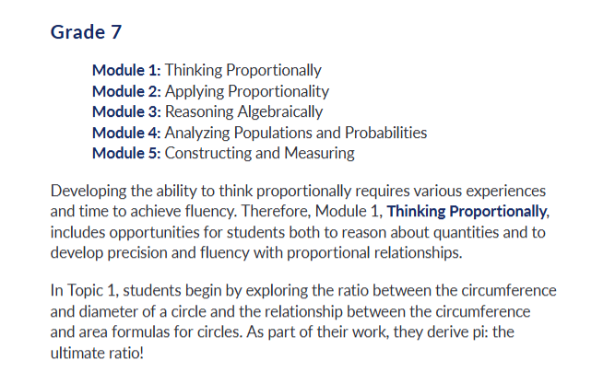
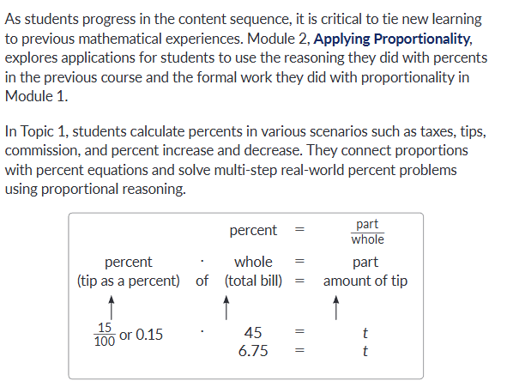
Learning Acceleration throughout Bluebonnet Learning Secondary Math
Throughout
Many standards are spiraled throughout modules and topics offering continuous opportunities progress towards proficiency.
Notes:
:10-:11
Say: Overall, many standards are spiraled throughout the module and the lessons, which offers continuous opportunities for progress towards proficiency. For example, when we look at the progression of Modules, you’ll notice that Thinking Proportionally establishes the foundation for the course. Students will be using skills and knowledge from Modules 1 and 2 throughout their 7th Grade year. TEKS show up repeatedly in successive modules, and it is meant to build student understanding over time – which is valuable when it comes to big concepts like Proportionality! This is also a great example of our RBIS Depth of Key Concepts – it’s not a “this week we learn proportionality and then we’re done” approach, but a true opportunity to spiral and repeat, which gives multiple opportunities to accelerate learning.

Slide 11
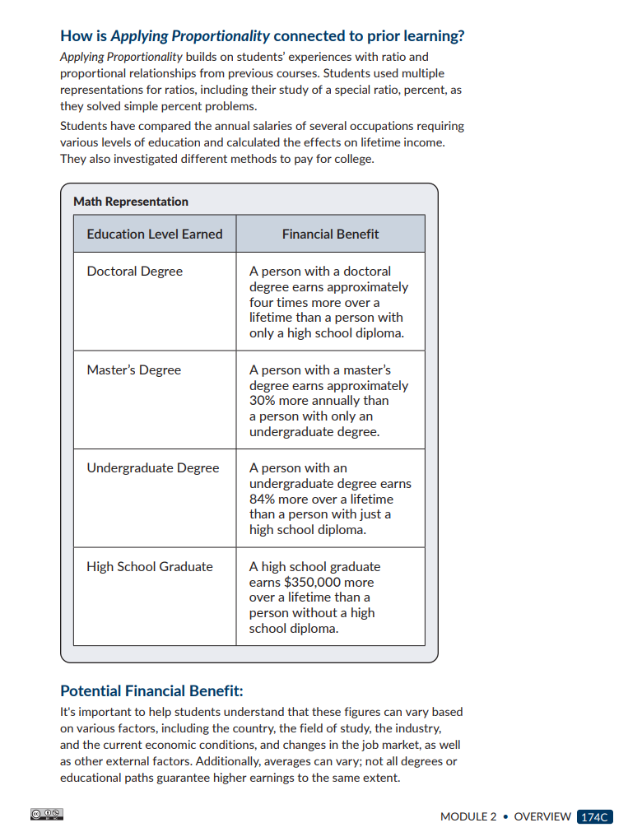
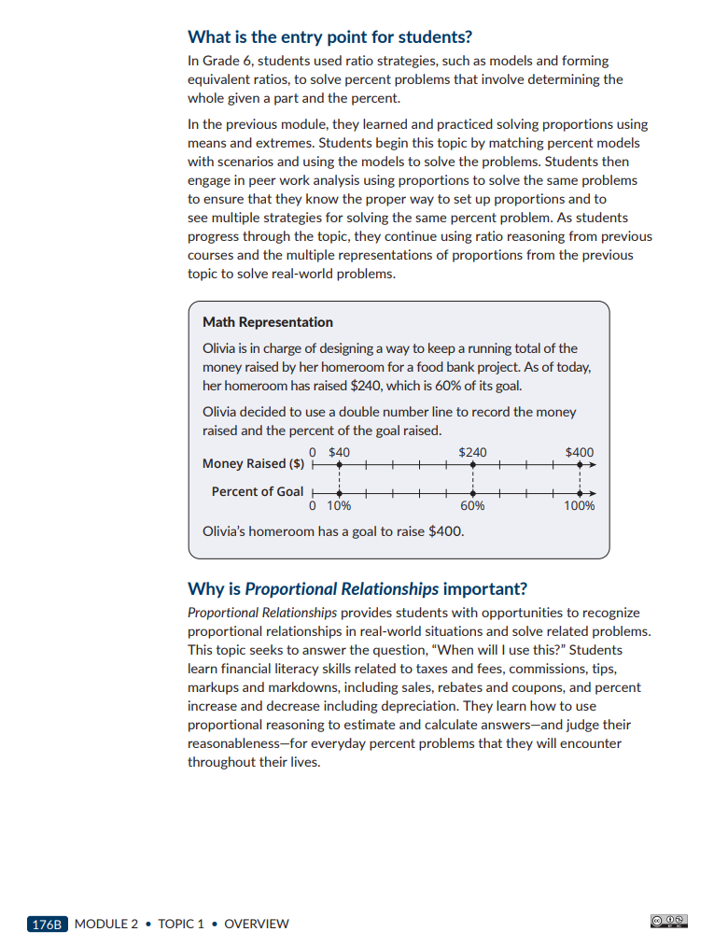
Learning Acceleration within the Module and Topic Overviews
Pg # 3
Connected to Prior Learning
Every module and topic includes a narrative addressing how the content connects to prior learning or grade levels. This can be found in the Module and Topic Overviews.
Consider and be ready to share:
How could a teacher use this to accelerate learning? What would be a concrete example?
Notes:
:11-:16
Say: Module and Topic narratives connect prior or continuous learning with the current learning. This highlights the materials alignment to the RBIS: Coherence of Key Concepts. Take a look at the examples on the slide and in your Guided Notes.
How a teacher could use this to accelerate learning. What would be a concrete example? Consider giving teachers 2-3 minutes to discuss in pairs, then ask for 1-2 volunteers to share whole group.
Possible example answers include:
Look at data from a prior assessment of those topics or skills
When internalizing a lesson, identify one skill connected to the content. Script a sentence to use to help students build coherence, such as “Last year, you learned ___ and today we’re going to use all that knowledge as we ___”

Slide 12
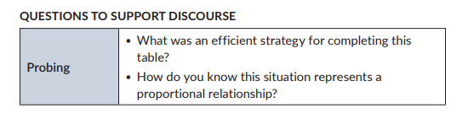
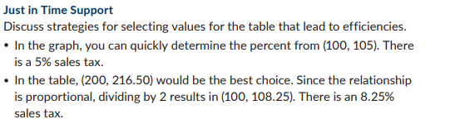
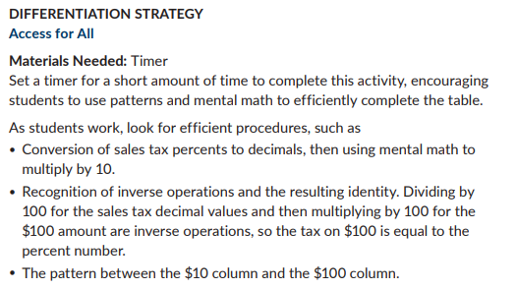
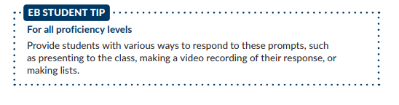
Learning Acceleration within Lessons
Pg # 5
Lessons
Questions to Support Discourse
Differentiation Strategy
Just In Time Support
EB Student Tip
Notes:
:18-:19
Say: Questions to support discourse, Differentiation strategies, Just In Time Supports and EP Student Tips offer scaffolds, accommodations, and suggestions for differentiation to ensure access for all learners. These examples come from Grade 7 Module 2 Topic 1 Lesson 3. Look over these examples in your guided notes or within Lesson 3 in your Combined Assessments document to see them in context.

Slide 13


Assessments and Learning Acceleration
Pg # 6
Formative assessments occur daily and are targeted to assess the lesson objective. They are checkpoints for the individual concepts and skills that will build toward the eventual summative assessment.
Summative assessments are comprehensive checkpoints that represent the summation of several lessons/weeks worth of skill and concept development. They typically come at the end of a module.​
Pinpoint opportunities within an upcoming lesson that can be used for learning acceleration
Pinpoint opportunities for learning acceleration within modules that spiral specific topics
Notes:
:19-:20
Say: Both formative and summative assessments can be used to collect data to inform learning acceleration. Data from formative assessments can be used to pinpoint places within an upcoming lesson that can be used for learning acceleration. Data from summative assessments can be leveraged to plan for learning acceleration within modules and topics that spiral specific topics. If you would like to explore or practice this more then explore the Student Work Analysis session.

Slide 14
Agenda- Types of Assessments
Introduction
Learning Acceleration
Types of Assessments in Bluebonnet Learning Secondary Math
Connecting Summative and Formative Assessments
Closing
Notes:
:20
20 min mark
Say: Let’s look at assessment types, then move into connecting formative and summative assessments.

Slide 15
Overview of Assessments
Summative assessments are comprehensive checkpoints that represent the summation of several lessons/weeks worth of skill and concept development. They typically come at the end of a Topic.​
Formative assessments occur daily and are targeted to assess the lesson objective. They are checkpoints for the individual concepts and skills that will build toward the eventual summative assessment.
Notes:
:20-:21
Say: Let’s start by defining the terms “summative” and “formative” when it comes to talking about assessments Ask for a volunteer to read each box on the slide.
Both types of assessment within Bluebonnet Learning Secondary Math provide teachers with a sense of direction. Summative assessments help teachers understand the destination they are aiming for within a module and formative assessments help them monitor their students’ progress toward that destination.​ Since assessments play such an important role in the effective implementation of Bluebonnet Learning Secondary Math, let’s familiarize ourselves the different types that are used in this HQIM.

Slide 16
Bluebonnet Learning Secondary Math Assessment Types
Pg # 6
Summative assessments are comprehensive checkpoints that represent the summation of several lessons/weeks worth of skill and concept development. They typically come at the end of a module.​
Formative assessments occur daily and are targeted to assess the lesson objective. They are checkpoints for the individual concepts and skills that will build toward the eventual summative assessment.
Questions to Support Discourse/ Student Look Fors
Talk the Talk
End-of-Topic Assessment
Skills Practice
Mid-Topic Assessment
Assessment Reflection
Performance Tasks (Optional)
Worked Examples
Notes:
animated slide
:21-:22
Say: Let’s take a moment and review the different assessments within Bluebonnet Learning Secondary Math and where they fit within our assessment types. (CLICK 5X) to reveal each Bluebonnet Learning Secondary Assessment type and its categorization. Depending on your teachers’ background knowledge, you may want to name the assessment first and ask for a volunteer to say if they think it is summative or formative and why before revealing each one.
Notes:
At this point, this is an initial introduction to the assessment and whether or not it is summative or formative. The following slides go more in-depth into the purpose of each, which helps clarify why they are formative/summative.

Slide 17
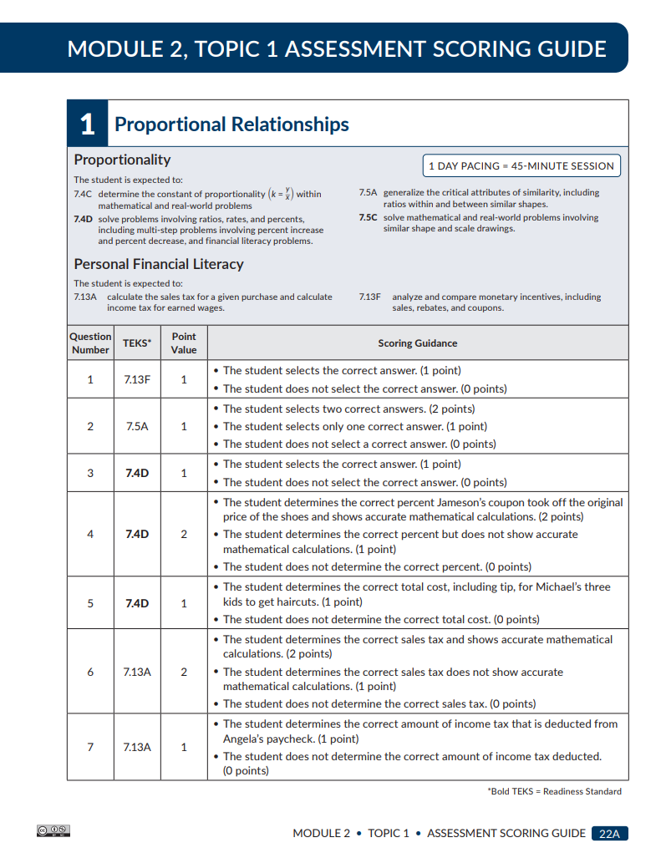

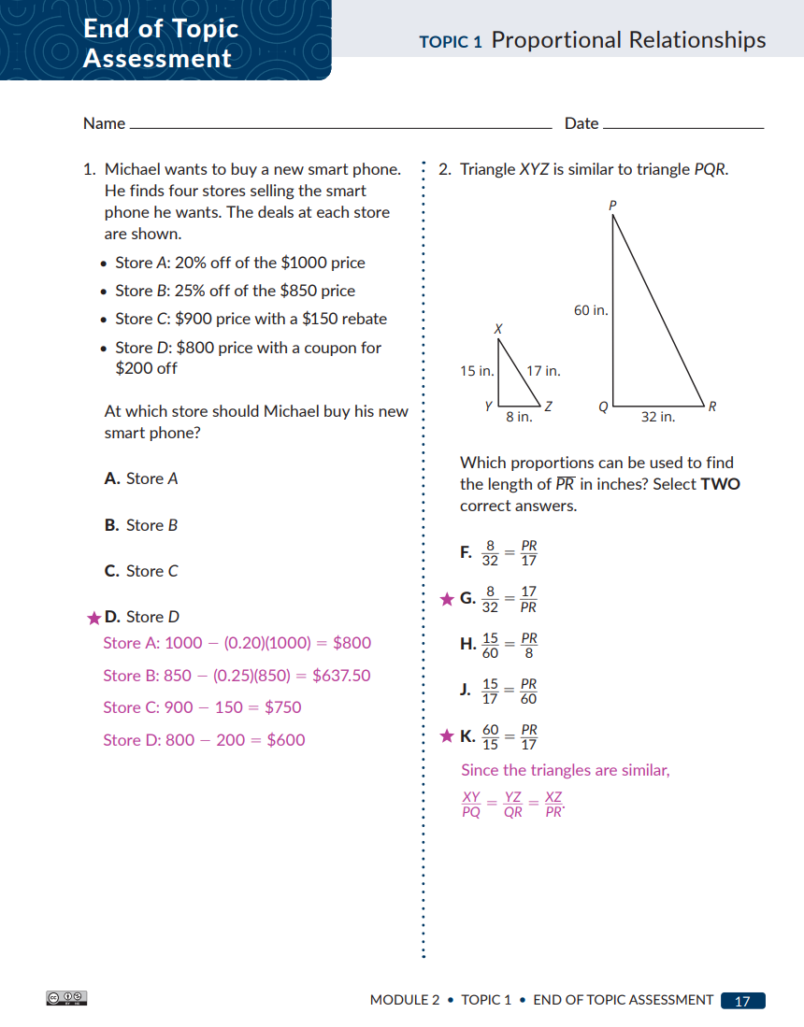
End-of-Topic Assessment
Summative Assessment
Purpose: To evaluate individual and class understanding of the TEKS aligned topics
Allows teachers to:
determine the next instructional steps
evaluate the need for small-group instruction or acceleration
Exit Ticket #5
You are preparing to teach an upcoming Bluebonnet Learning Secondary Mathematics topic while reflecting on previous assessment data to identify gaps in learning. Which of the following approaches is most aligned to learning acceleration? ​
Ans: C
Strategically prioritize knowledge, standards, skills, or tasks from prior grade(s) that
should be taught before the grade-level content in this particular module.​
Notes:
:22-:23
Say: We’re going to go through brief examples of what each assessment looks like with 7th Grade Module 2 Topic 1 as our example. If you’d like to read more about the assessments, please use the Program and Implementation Guide.
On the slide, you can see excerpts from the Grade 7 Module 2 Topic 1 End-of-Topic Assessment. You are provided with the student-facing assessment questions, the rubric, and the answer key. Call on a participant to read the purpose of the end-of-module assessment.
When supporting your teachers through administering this assessment, listed below is guidance to keep in mind:
It is recommended to administer either the print or the digital assessment method of the End of Topic Assessment.
Do NOT allow a calculator (Grade 6 and Grade 7 only)
Provide a 45-minute time allotment for each assessment.
For consistent evaluation follow the Assessment Scoring Guide.
Use the provided Response to Student Performance to help inform next instructional steps.
I also want to note that longer Topics will have mid-topic assessments to formatively assess student proficiency.

Slide 18
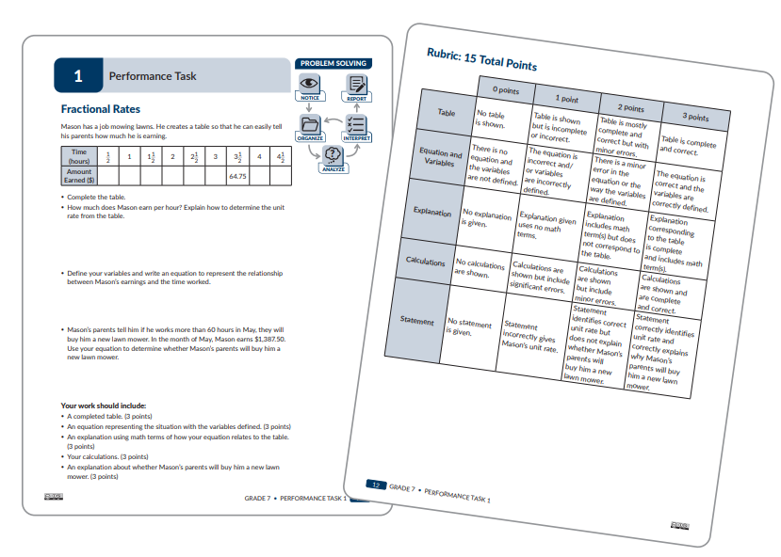
Performance Task (Optional)
Pg # 6
Summative/Formative Assessment
Purpose: To provide opportunities for students to problem solve, strategize, and demonstrate their learning from the entire course.
Allows teachers to: utilize a rubric to assess individual and class depth of understanding as aligned to the TEKS.
Notes:
:24-:25
Say: On the slide, you can see the Grade 7 Module 2 Topic 1 Performance Tasks. These are optional and teachers can use them as an extra opportunity to demonstrate their learning. The Performance Tasks for each Module are located at the end of the Assessment Guide for each grade level. Call on a participant to read the purpose of the Performance Task.
When supporting your teachers through administering this assessment, listed below is guidance to keep in mind:
Do the Math.
Review the Facilitation Notes.
Use the problem-solving model to complete the task.
Direct students to reference the rubric and use the rubric to evaluate the student’s work

Slide 19
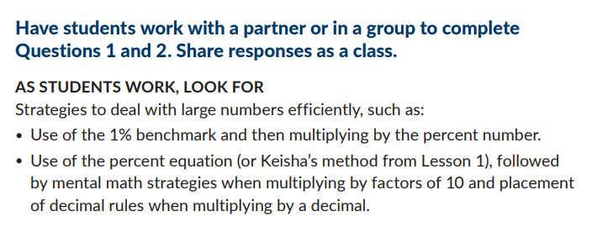
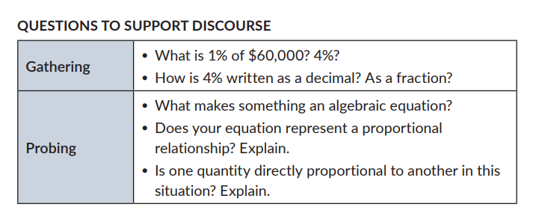
Questions to Support Discourse and Student Look-fors During Activities
Formative Assessment
Purpose:
To provide checks for understanding used to assess individual student and class progress towards proficiency of TEKS aligned lessons.
To inform the instructional steps for the teacher during the lesson.
Allows teachers to:
Adapt instruction to meet the needs of an individual student or class.
Scaffold support or extend the learning when needed.
Notes:
:25-:26
Say: On the slide, you can see examples for “Student Look Fors” and “Questions to Support Discourse” from Grade 7 Module 2 Topic 1 Lesson 3. These are formative assessments that teachers can use during Lessons and Activities to Check for Understanding. Call on a participant to read the purpose of “Student Look Fors” and “Questions to Support Discourse”.
When supporting your teachers through administering this assessment, listed below is guidance to keep in mind:
Do the math of the lesson.
Read through the Facilitation Notes.
Select Questions to Support Discourse to use during class.
Consider creating your own questions that will guide and deepen student understanding.

Slide 20
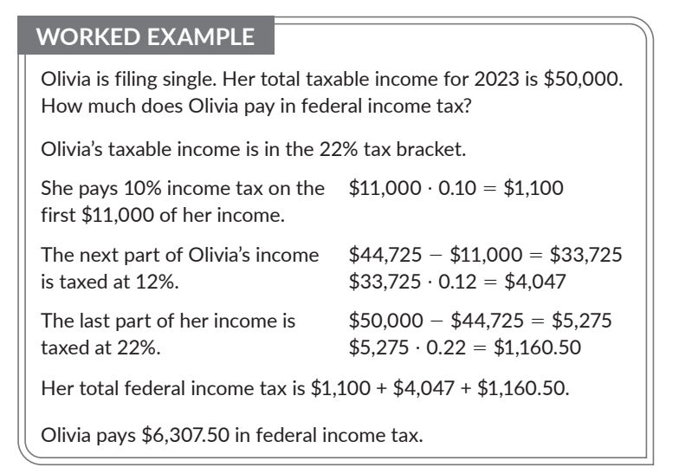
Worked Examples During Activities
Worked Examples: Thumbs Up/Thumbs Down Problems; Who’s Correct Problems
Pg # 6
Formative Assessment
Purpose: Worked Examples provide a means for students to view each step taken to solve the example problem
Allows Teachers to check for understanding and common misconceptions during the lesson as:
Students interact with Worked Examples
Students explain the progression of the Worked Example
Notes:
:23-:24
Say: On the slide, you can see excerpts from Worked Examples in the same Grade 7 Module 2 Topic 1 Lesson 3. Call on a participant to read the purpose of Worked Examples.
When supporting your teachers through administering this assessment, listed below is guidance to keep in mind:
Refer to the lesson Facilitation Notes for strategies to help students interact with the Worked Example.
Prepare a classroom environment that expects students to collaborate, discuss, justify, and share their mathematical reasoning.

Slide 21
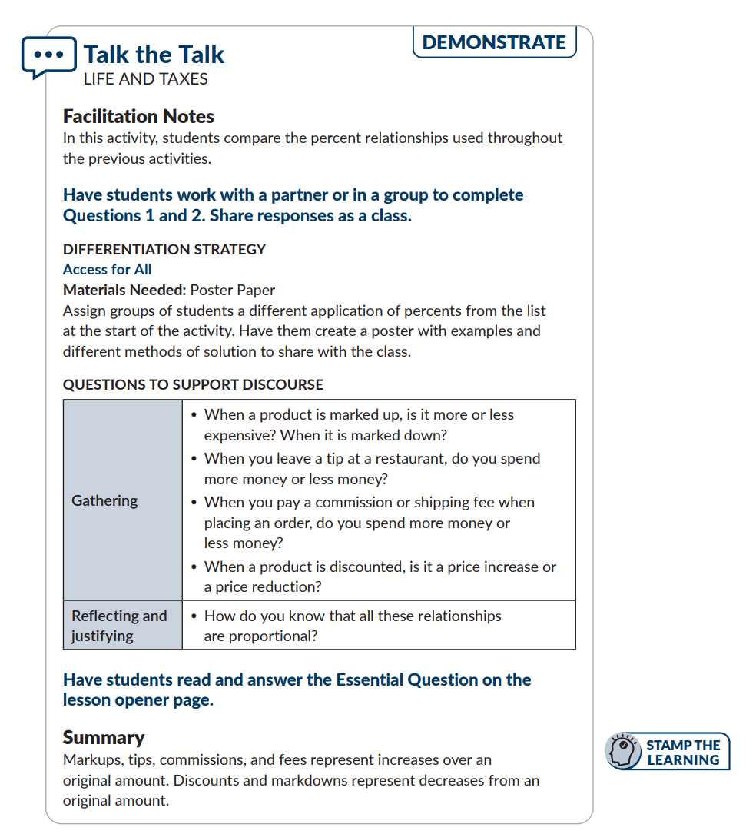
Pg # 7
Talk the Talk
Formative Assessment
Purpose: To assess student learning and to make decisions about helpful connections you need to make in future lessons
Allows teachers to:
identify common understandings and misunderstandings from the class
inform plans for future lessons
Exit Ticket #3
A teacher notices their students are struggling with solving real-world problems using the diameter, circumference, and area of a circle (TEKS 7.9B&C), which is assessed on the Module 1 Topic 1 Assessment. Which of the following formative assessments would give them the best information on how their students are progressing toward mastering this skill? ​
D Lesson 3 Talk the Talk: Students will solve real-world problems about circular regions using diameter, circumference, and area.
Notes:
:26-:27
Say: On the slide, you can see the the Teacher Facing, Grade 7 Module 2 Topic 1 Lesson 3, “Talk the Talk” formative assessment with facilitation notes. Call on a participant to read the purpose of Talk the Talk.
When supporting your teachers through administering this assessment, listed below is guidance to keep in mind:
Direct students to self-assess, monitor their own progress, and ask clarifying questions.
Instruct students to revisit the Essential Question posed on the lesson opening page to gauge their understanding.

Slide 22
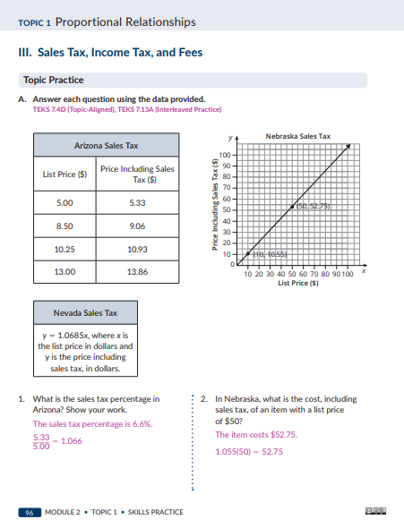
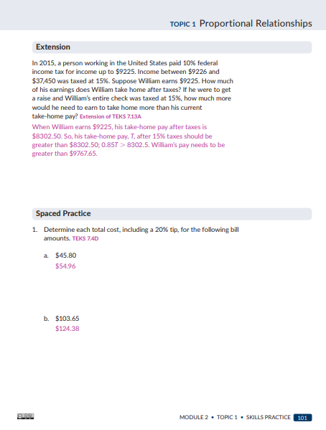
Skills Practice- Spaced Practice
Formative Assessment
Purpose: To provide spaced retrieval of course-level skills.
Allows students to:
recall and remember skills taught previously in the course
build proficiency with course-level TEKS
Exit Ticket #1
How does the Skills Practice formative assessment connect to the Research-Based Instructional Strategy (RBIS) of Productive Struggle?​​​
Answer: B
Students work independently on practice problems, so they are engaged in productive problem solving and have multiple opportunities for practice.​​
Notes:
:26-:27
Say: Finally, you’ll see the Grade 7 Module 2 Topic 1 Skills Practice work. For formative assessment purposes, we want to hone in on the Spaced Practice portion. Call on a participant to read the purpose of the Skills Practice Spaced Practice.
You notice here, the alignment to RBIS Coherence of Key Concepts: When supporting your teachers through administering this assessment, listed below is guidance to keep in mind:
Direct students to the Spaced Practice section of the Skills Practice for the lesson.
Instruct students to complete the problems independently.
Gauge student understanding and review concepts or skills as needed with individual students.

Slide 23
Connections to the RBIS
End-of-Topic Assessments: include questions that assess a Balance of Conceptual and Procedural understandings as required by the standards. The questions align with and meet the rigor of the TEKS, which means they demonstrate a Depth of Key Concepts.
Skills Practice: skills and Each topic includes a set of Skills Practice problems that focusing on Learning concepts students learn in the topic. Students apply both their Conceptual and Procedural knowledge from the lesson.
Talk the Talk: All lessons conclude with a Talk the Talk that illustrates Depth of Key Concepts by focusing on the most important topics of the grade level. There is also Coherence of Key Concepts as the content connects and builds from one day to the next.
Performance Tasks: These formative assessments provide an opportunity for students to engage in Productive Struggle as they work independently on problems. The variety in these problems help achieve Depth of Key Concepts by addressing all parts of the standards.
Notes:
animated slide
:27-:28
Say: Every Research-Based Instructional Strategies (RBIS) for math can be connected to the Bluebonnet Learning Secondary Math assessments, because the RBIS are woven into all the instructional materials. For each assessment type, let’s look at one connection you could make to the RBIS. (CLICK) to reveal and read each box. All RBIS are connected to all assessments – these are just a few examples.

Slide 24
Agenda- Connecting Summative and Formative
Introduction
Learning Acceleration
Types of Assessments in Bluebonnet Learning Secondary Math
Connecting Summative and Formative Assessments
Closing
Notes:
:28
28 min mark
Say: In our next section, you will explore the connection between summative and formative assessments used in Bluebonnet Learning Secondary Math. Using an analyzed summative assessment, you will practice identifying how it aligns with formative assessments used in lessons that build up to it. Ultimately, you will see how formative assessments empower teachers to know how well their students are progressing toward mastery of the module’s objectives and standards and to respond accordingly.​

Slide 25

The Power of Knowing Our Destination
Notes:
:28-:29
Say: Few travelers would begin a trip without knowing where they’re headed. And the same can be said of teachers who implement Bluebonnet Learning Secondary Math effectively. Before setting off on the journey they are taking their students on within a module or topic, teachers must have a clear picture of their final destination. In other words, they must know the specific TEKS and ELPS that are the focus of the module and how students’ mastery of them will be assessed.​
We want to support our teachers in knowing their destination. We also strengthen their ability to accurately gauge their students’ progress toward that destination by knowing what specific aspects of students’ performance they should look for during daily lessons. This empowers teachers to determine when students are on track or off track and to respond accordingly.​
In Bluebonnet Learning Secondary Math, the tight alignment between the end-of-topic summative assessment (the destination) and the formative assessments used in daily lessons (the path that leads to it) is not an accident. Rather, it’s by design. When we support our teachers to see the direct connection between the formative assessments used in daily lessons and the end-of-module assessment to which they align, we help them ensure that their students successfully arrive to their final destination. ​

Slide 26
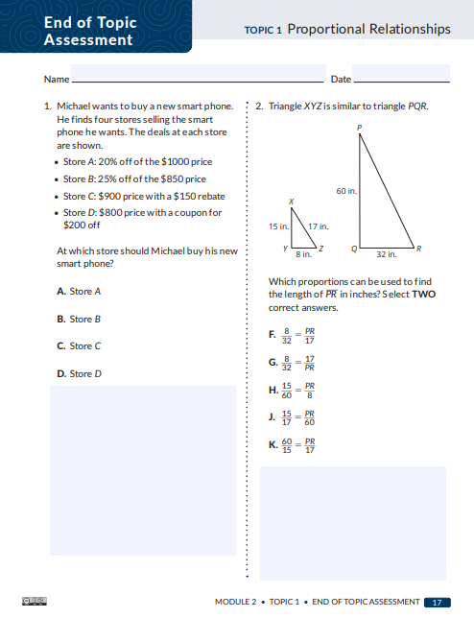
Summative Assessment Deep Dive
Directions:
Open the Grade 7 Module 2 Topic 1 End of Topic Assessment
Skim the entire assessment
Prioritize completing these problems: 3, 4, 6, and 8.
Consider and be ready to share:
What critical knowledge and skills does this assessment require of students?
Exit Ticket #2
What is the ultimate goal of understanding how to use assessments effectively? ​​
C) Prepare students to master the TEKS for their grade level​​
Notes:
:29-:39
Say: Assessments play a critical role in the successful implementation of Bluebonnet Learning Secondary Math. To support our teachers in using assessments effectively, we must have a deep understanding of the different types that exist within Bluebonnet Learning Secondary Math and the specific purpose of each. ​Let’s begin our exploration of the various assessments used in Bluebonnet Learning Secondary Math by taking one and then reflecting on that experience. You will begin by opening the Grade 7 Module 2 Topic 1 End of Topic Assessment. Because we want to maximize our time together and truly focus in on how the summative and formative assessments support one another, start by skimming the entire assessment. Then you’ll prioritize completing problems 3, 6, 8 and 10. ​ Review the directions on the slide. Give participants 7 minutes to work (more if you have the time). You can choose for them to work independently or collaboratively.
Reflect on that experience by sharing: What knowledge and skills must students possess in order to be successful on this assessment?​
Notes:
Optional follow up reflection question if time permits: How might a deep understanding of what is required of students on this end-of-topic assessment improve your ability to monitor and respond to students’ progress throughout the module?

Slide 27
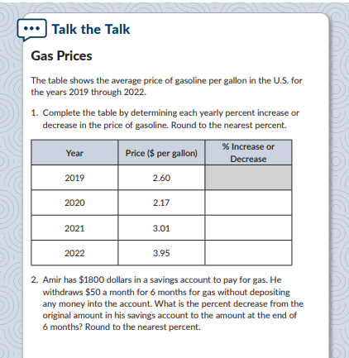
Formative Assessment Deep Dive 1
Directions:
Open Grade 7 Module 2 Topic 1 Lesson 4 Talk the Talk
Skim the entire formative assessment
Complete problems 1 and 2.
Consider and be ready to share:
How is this formative assessment connected to the summative assessment you examined?​
What data are teachers able to collect from this formative assessment that will help them better support all students to make progress towards proficiency with the standards and objectives of the topic?
Notes:
:39-:43
Say: Now you will take a formative assessment that is tied to the summative assessment you previously examined and then reflect on ways in which the two are connected. Review the directions on the slide and give participants 3 minutes to work. The connections video on the next slide will review these two assessments in detail.
Note:
Hand out hard copies of the assessment and give participants 3 minutes to work (more if you have the time). You can choose for them to work independently or collaboratively.

Slide 28
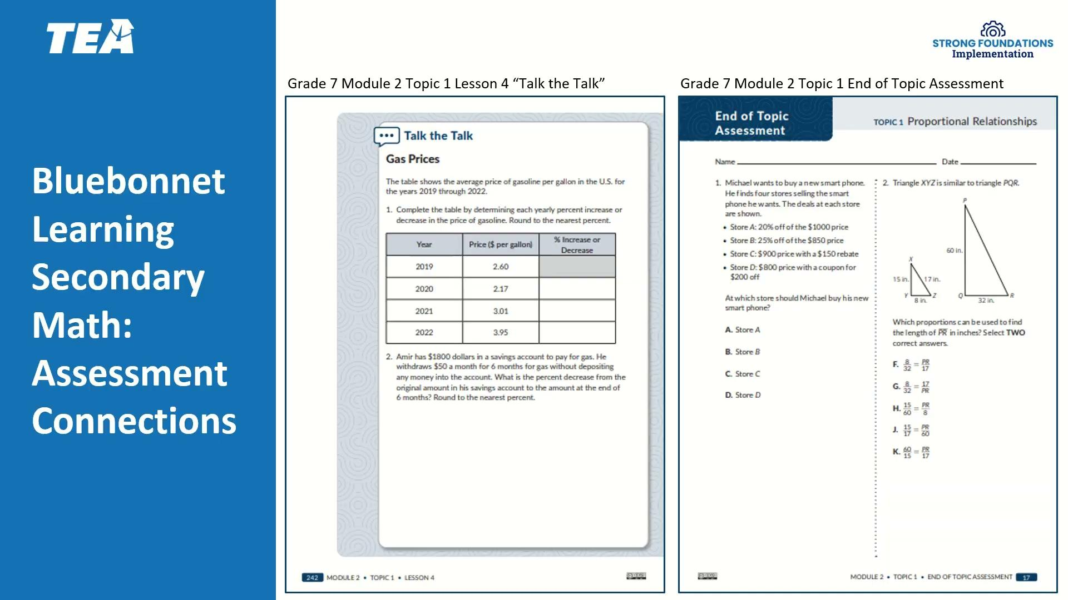
Unpacking Connections Video
Notes:
:43-:47
Say: Now that you’ve worked through a formative assessment from Bluebonnet Learning Secondary Math, let’s unpack how it’s connected to the summative assessment you completed. Watch the video to learn more.
Notes and Resources:
Video Link: https://drive.google.com/file/d/1lvGNNQybkYc8zHoOHBOi54wdViJOq2ub/view?usp=sharing
Play the video (3 minutes). Links provided have closed captions

Slide 29
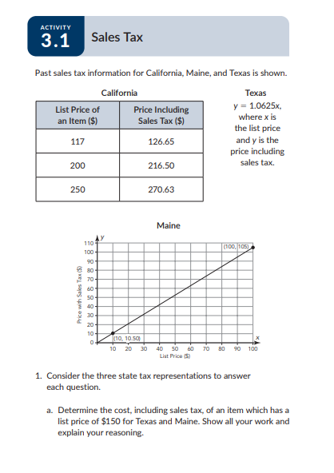
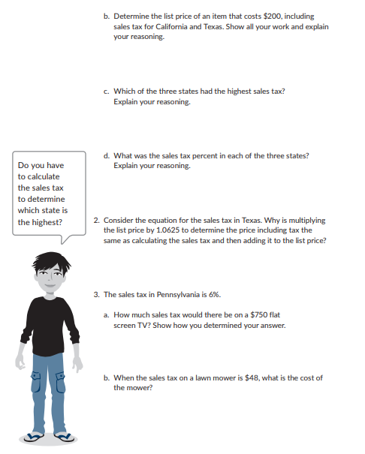
Formative Assessment Deep Dive 2
Directions:
Open the Grade 7 Module 2 Topic 1 Lesson 3 Activity 3.1 Sales Tax
Skim the entire formative assessment
Complete the activity prioritizing Problem 3a and b
Consider and be ready to share:
How is this formative assessment connected to the summative assessment you examined?​
What data are teachers able to collect from this formative assessment that will help them better support all students to make progress towards proficiency with the standards and objectives of the module?
Notes:
:47-:55
Say: To deepen our understanding of the alignment between summative and formative assessments used in Bluebonnet Learning Secondary Math, let’s now look at a second formative assessment and reflect on how it is connected to the summative assessment we analyzed at the start. Review the directions on the slide. The questions are the same as the previous formative deep dive. Give participants 3 minutes to work (more if you have the time). You can choose for them to work independently or collaboratively. After 3 minutes, provide participants with time to discuss their answer to the two questions.

Slide 30
Agenda- Closing
Introduction
Learning Acceleration
Types of Assessments in Bluebonnet Learning Secondary Math
Connecting Summative and Formative Assessments
Closing
Notes:
:55
55 min mark
Say: Let’s close out with a reflection to summarize our learning then move to our Next Steps.

Slide 31
Synthesize Your Learning
Consider the example assessments and what you’ve learned about learning acceleration. Answer the following questions:
What is the difference between summative and formative assessments?​
How can coaches support teachers in using Bluebonnet Learning Secondary Math assessments to make decisions that ensure learning acceleration takes place for all students?
Exit Ticket #4
You are completing the Lesson Internalization Protocol for an upcoming lesson. You are considering how to best help students who are experiencing learning gaps using a learning acceleration approach. Which of the following adjustments would NOT be considered a learning acceleration approach?
Answer: B
​​
Reviewing the modules and topics from the previous grade level to reteach isolated
skills students have not yet mastered.​
Notes:
:56-:59
Say: There are a few questions I’d like you to consider as you synthesize your learning. Read the 2 questions on the slide. Take a few minutes to consider your own practices in your school and reflect on the essential questions. You can jot your ideas down in your Guided Notes. Pause for 2 min for reflection. If time allows, ask for volunteers to share their reflections to one of the questions.

Slide 32
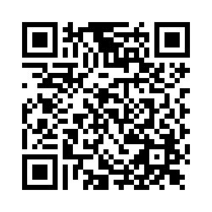
Complete the following tasks using your learning today:
  Exit Ticket
  Task 1
  Task 2
For general questions, please contact Name at email address.
Next Steps
Exit Ticket
Notes:
Notes:
Insert any important links in the slide. This can specific next steps, tasks, etc. If you have a facilitation survey, include that information as well.
Contact Information for session questions should be provided. Also share any other resources that may also be available like an FAQ, Office Hours, newsletters, etc.
If you know the next date and time of your next session(s) with this audience, please include those dates and times as well.
Exit Ticket
Recommend timing=5-10 min
Link: https://tea.co1.qualtrics.com/jfe/form/SV_6nj42JVVlU4hveK

Slide 33
Exit Ticket
Notes:
Exit Ticket
Recommend timing=5-10 min
Link: https://tea.co1.qualtrics.com/jfe/form/SV_6nj42JVVlU4hveK
You can choose to give participants 10 minutes to complete the exit ticket independently by adding to the guided notes or creating a separate document. The questions, answers, and rationale are included below in the slides just in case you want to review the exit ticket after giving it or use the questions to stamp key ideas at the end of the session. If you choose to review the questions, answers and rationale included in the slides with participants, please ensure the Exit Ticket link has been utilized first.

Slide 34
Exit Ticket Part1
1. How does the Skills Practice formative assessment connect to the Research-Based Instructional Strategy (RBIS) of Productive Struggle?​​​
Students struggle while completing the Skills Practice, which – if they get all problems correct – will be productive.​
Students work independently on practice problems, so they are engaged in productive problem solving and have multiple opportunities for practice.​​
Skills Practice questions are in order from least to most challenging, so as students work, they will struggle more and more.​​
Productive Struggle is not connected to the Skills Practice.​
Correct Answer Rationale: Productive Struggle means students engage in productive problem solving, engaging in multiple opportunities for practice. During the Skills Practice, students work independently on practice problems, which is best aligned with the RBIS definition.​
​​2. What is the ultimate goal of understanding how to use assessments effectively? ​​
Learn how to “teach to the test”​​
Learn how to help students get higher test scores​​
Prepare students to master the TEKS for their grade level​​
Prepare students to be better test-takers​​
Correct Answer Rationale: The ultimate goal of the lessons and units/domains that make up Bluebonnet Learning Secondary Mathematics is to prepare students to master the TEKS for their grade level. It is not mastery of the assessments but rather mastery of TEKS that is the focus. Therefore, instead of “teaching to the test,” teachers should focus on ensuring all students are mastering the TEKS.

Slide 35
Exit Ticket Part 2
3. A teacher notices their students are struggling with solving real-world problems using the diameter, circumference, and area of a circle (TEKS 7.9B&C), which is assessed on the Module 1 Topic 1 Assessment. Which of the following formative assessments would give them the best information on how their students are progressing toward mastering this skill? ​
Lesson 1 Assignment: Students will apply mathematical process standards to develop geometric relationships with volume. The student is expected to use models to determine the approximate formulas for the circumference and area of a circle and connect the models to the actual formulas.
Lesson 1 Activity 1.1: Students compare the radii, diameters, and circumferences of two circles, one with a radius twice as long as the other. They are guided to notice that a circle with a radius half as long has a circumference half as long as well, while the ratio of circumference to diameter (pi) remains constant.
Lesson 2 Activity 2.1: Students solve a problem in which the area of a pipe’s cross section is related to the amount of water it can deliver. They then compare two different pipe systems using what they know about the area of the circle.
Lesson 3 Talk the Talk: Students will solve real-world problems about circular regions using diameter, circumference, and area.
Correct Answer Rationale: While Assignments, Exit Tickets, and Talk the Talks are all formative assessments that could provide useful data, in Lesson 3, the Talk the Talk is most aligned to the standard.

Slide 36
Exit Ticket Part 3
4. You are completing the Lesson Internalization Protocol for an upcoming lesson. You are considering how to best help students who are experiencing learning gaps using a learning acceleration approach. Which of the following adjustments would NOT be considered a learning acceleration approach? ​​
Locating Standards that students will need to be familiar with prior to engaging in the new learning. ​
Reviewing the modules and topics from the previous grade level to reteach isolated skills students have not yet mastered.​
Identifying TEKS that are spiraled throughout each module offers continuous opportunities for student mastery. ​
Reading the embedded supports in the Course and Implementation Guide to identify opportunities to scaffold for specific groups of students​
Correct Answer Rationale: Bluebonnet Learning Secondary Mathematics is designed for lesson acceleration with just-in-time supports, including the TEKS that are spiraled throughout each module and topic, and the CIG supports that identify scaffolds. Reteaching isolated skills is remediation, not acceleration.

Slide 37
Exit Ticket Part 4
5. You are preparing to teach an upcoming Bluebonnet Learning Secondary Mathematics topic while reflecting on previous assessment data to identify gaps in learning. Which of the following approaches is most aligned to learning acceleration? ​
Delay the start of grade-level instruction until you know all students have mastered the TEKS from previous grade levels.​
Begin grade-level instruction immediately to ensure you stay on pace with district calendars. You can’t control if students have mastered content from previous grade levels.​
Strategically prioritize knowledge, standards, skills, or tasks from prior grade(s) that should be taught before the grade-level content in this particular module.​
Intentionally adjust the scope and sequence so that there are at least three days of review prior to each End-of-Topic Assessment, and three days of reteaching after. ​
Correct Answer Rationale: Accelerated Learning strategically prepares students for success in current grade-level content. Past concepts and skills are addressed, but always in the purposeful context of current learning.​
​

